Slide 1
Robotics Technical Assessment Presentation
Kwabena Osei-Nai Jed Darko
BSc. Electrical and Electronics Engineering
Ashesi University

Slide 2
Table of contents
01
04
02
05
03
06
Project Overview
Velocity Command Generation
Control Approach
Assumptions and Limitations
Pose Error Computation
Demonstration & Results

Slide 3
Project Overview
Objective
Develop a custom pose controller for the TurtleBot3 Burger that navigates the robot to any desired pose without using the ROS2 Navigation Stack (Nav2).
System Inputs
Current robot pose from /odom
User-defined goal (x, y, θ) through the MoveToPose service
System Outputs
Linear velocity (linear.x)
Angular velocity (angular.z)
Key Features
Closed-loop feedback control
Continuous motion
Final orientation alignment
Gazebo Classic simulation

Slide 4
Control Approach
Controller Workflow
Receive goal pose
Read current robot pose from odometry
Compute pose errors
Generate velocity commands
Publish /cmd_vel
Repeat until the goal is reached
Why Proportional Control?
Simple to implement
Smooth behaviour
Stable for this application
Velocity naturally decreases near the goal
Control Strategy
Proportional linear controller
Proportional angular controller
Continuous correction using odometry
Simultaneous translation and rotation

Slide 5
Pose Error Computation
2. Heading Error
heading_error = desired_heading − current_heading
where
desired_heading = atan2(dy, dx)
1. Distance Error
distance_error = √(dx² + dy²)
3. Orientation Error
orientation_error = goal_theta − current_heading
normalize_angle()

Slide 6
Velocity Command Generation
Linear Velocity
linear.x = k_linear × distance_error
Robot slows down as it approaches the goal.
Maximum speed is limited to 0.25 m/s.
Final Orientation
After reaching the target position,
angular.z = k_angular × orientation_error
until the heading error is within the specified tolerance.
Angular Velocity
angular.z = k_angular × heading_error
Robot continuously steers toward the goal.
Angular velocity is limited for stability

Slide 7
Assumptions and Limitations
Assumptions
Accurate odometry measurements
Flat indoor environment
No moving obstacles
Robot starts with a valid pose estimate
The goal is reachable
Known Limitations
Uses only proportional control
No obstacle avoidance
Sensitive to odometry drift
Single goal at a time
Requires manual gain tuning

Slide 8
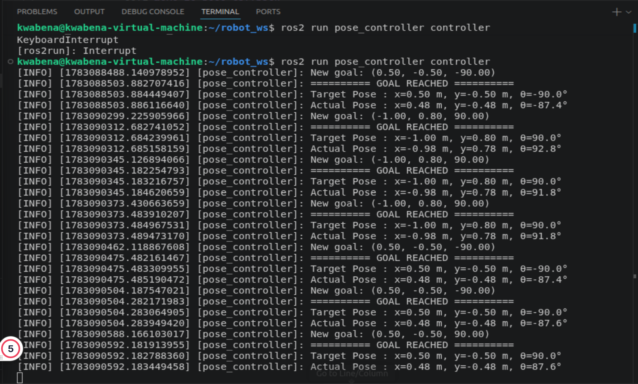
Demonstration & Results
Results
Successfully navigated to all target poses
Continuous motion achieved
Final heading accurately aligned
Robot stopped within specified tolerances

Slide 9
Thank You
Do you have any questions?

